Slide 1
Lecture 1 Introduction to Artificial Intelligence
CS 180 – Intelligent Systems
Dr. Victor Chen
Fall 2022

Slide 2
Overview
What is AI?
AI history
AI Applications
Smart Agent
PEAS model

Slide 3
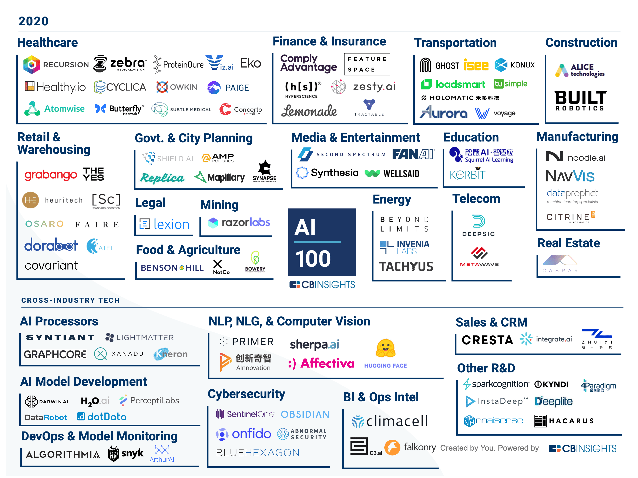
100 most promising AI startups redefining industries
https://www.cbinsights.com/research/artificial-intelligence-top-startups/

Slide 4
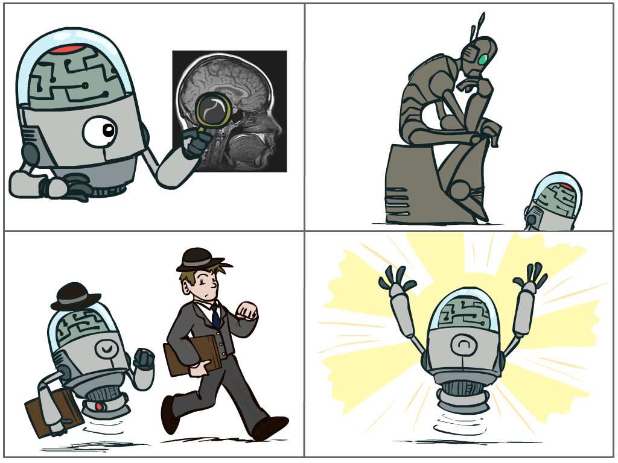
What is AI ?
A study on how to program computers to solve hard problems that traditionally require human intelligence to solve
Thinking humanly
Acting humanly
Thinking rationally
Acting rationally

Slide 5
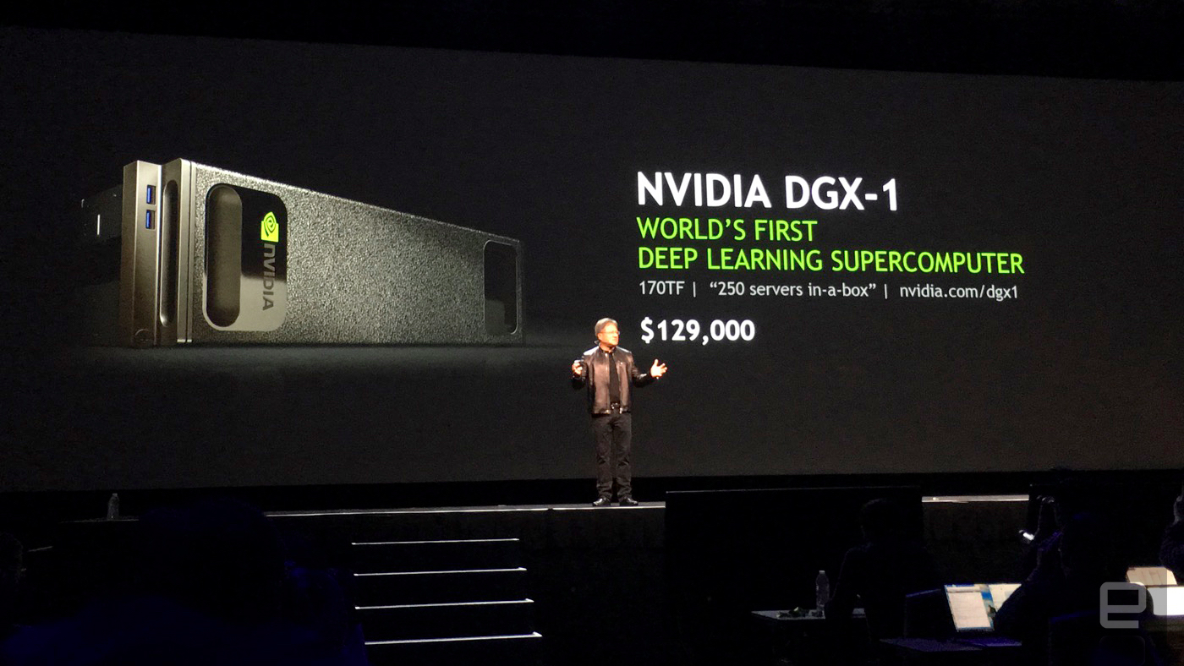
History of AI to the present day
1980s Expert systems boom
Late 1980s Expert system bust; the AI winter
Mid-1980s Neural networks, backpropagation
Late 1980s Uncertain/Probabilistic knowledge reasoning
1990s Machine learning becomes dominant, begins to flourish
Late 2000s Big data come to the stage
2010s Deep learning started to flourish everywhere
New industry boom

Slide 6
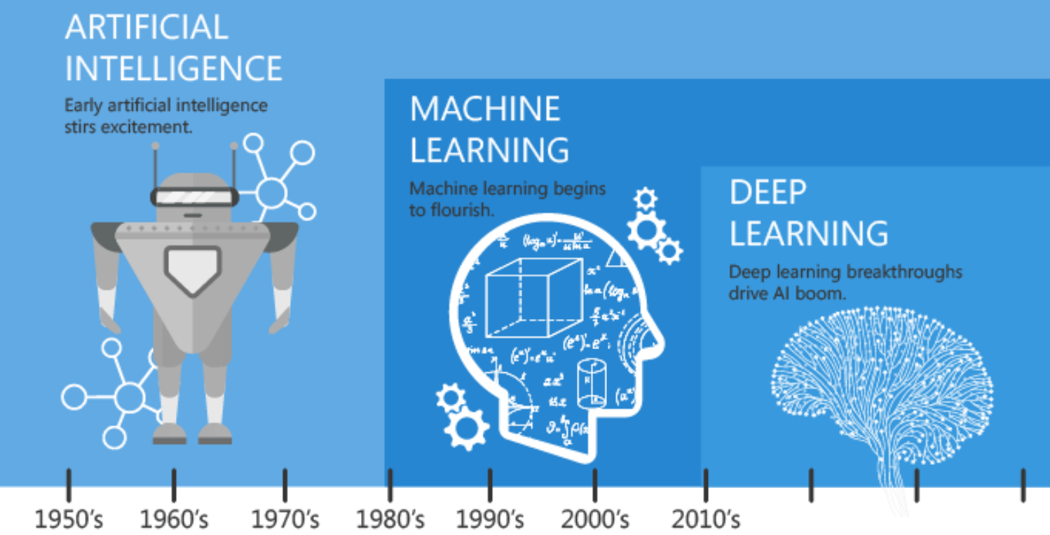

Slide 7
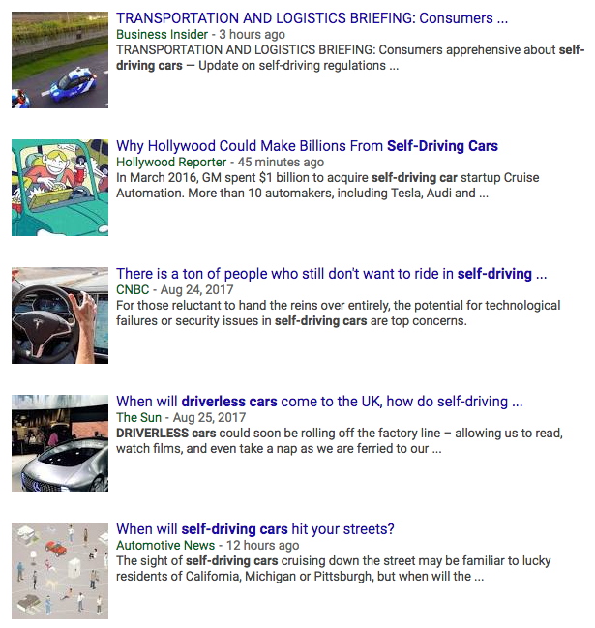
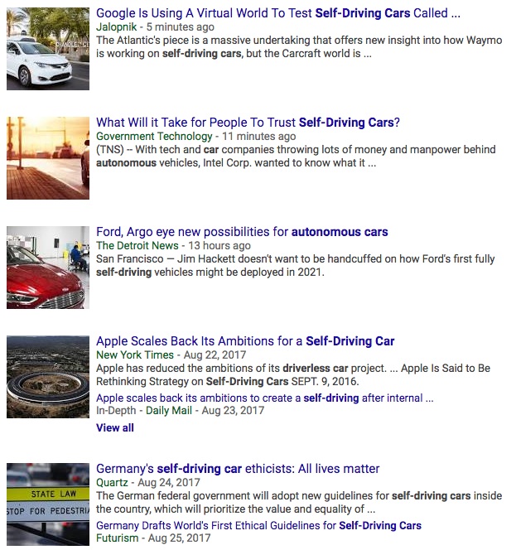
AI Applications: Self-driving cars
Video: A ride in a Waymo driverless car

Slide 8
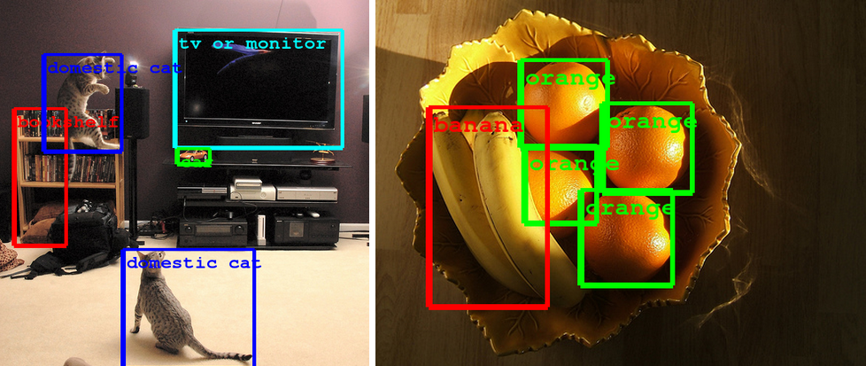
AI Applications: Computer Vision
Computer Eyesight Gets a Lot More Accurate, NY Times Bits blog, August 18, 2014

Slide 9
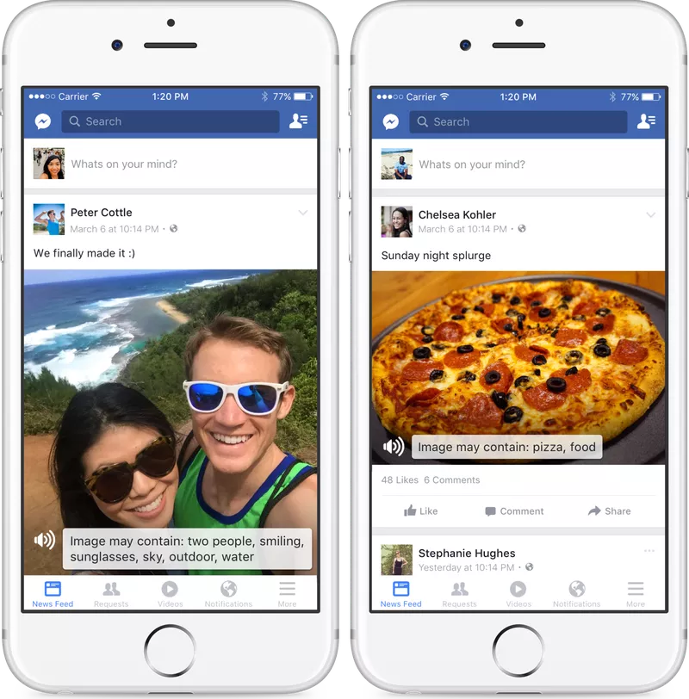
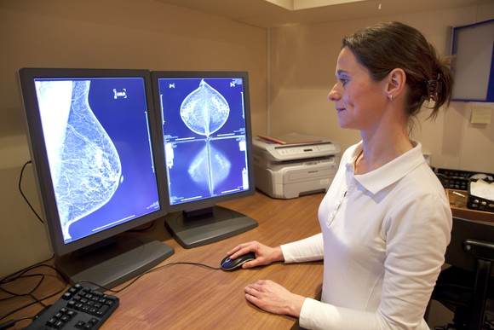
AI Applications: Computer Vision
AI beats human pathologists at detecting cancer/tumor
Facebook accessibility tools for the visually impaired (convert images to captions)

Slide 10
AI Applications: Computer Vision
https://thing-translator.appspot.com/
https://quickdraw.withgoogle.com/
https://modeldepot.github.io/tfjs-yolo-tiny-demo/
https://experiments.withgoogle.com/imaginary-soundscape

Slide 11
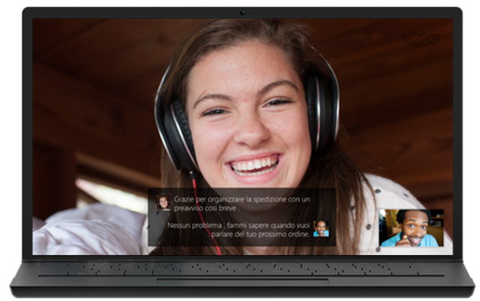
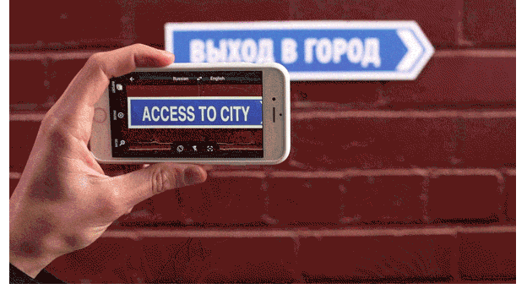

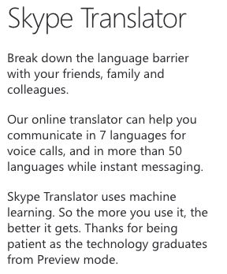
AI Applications: Speech and natural language
Google Translate App
Translate between 103 languages by typing
Offline: Translate 52 languages when you have no Internet
Instant camera translation: Use your camera to translate text instantly in 30 languages
Camera Mode: Take pictures of text for higher-quality translations in 37 languages
Conversation Mode: Two-way instant speech translation in 32 languages
Handwriting: Draw characters instead of using the keyboard in 93 languages
https://www.skype.com/en/features/skype-translator/
https://play.google.com/store/apps/details?id=com.google.android.apps.translate&hl=en

Slide 12
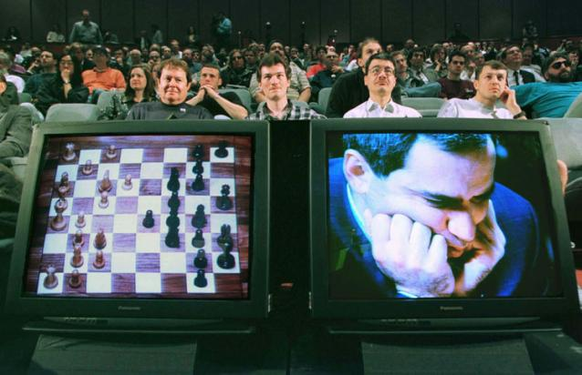
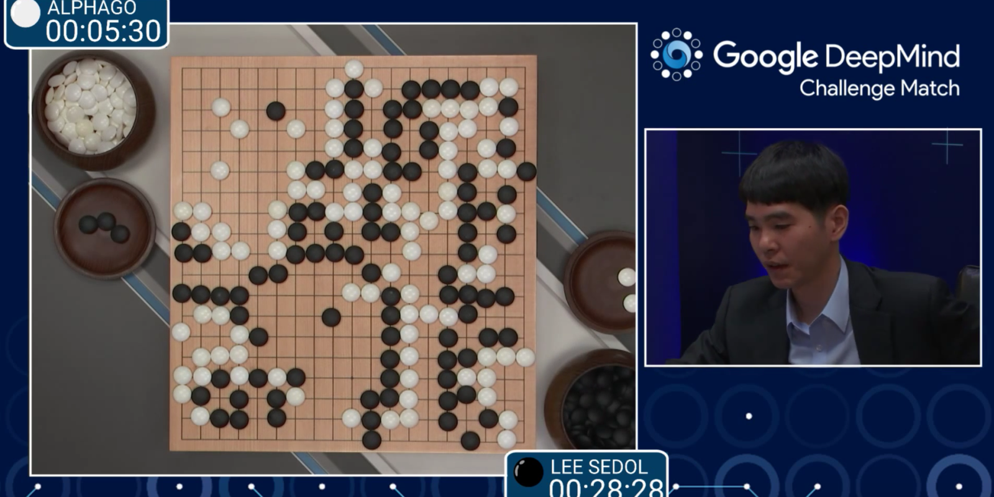
AI Applications: Games
1997: IBM’s Deep Blue defeats the reigning world chess champion Garry Kasparov
1997: Deep Blue Beats Kasparov
2007: Checkers is solved
AI programs have been beating the best humans
2016: AlphaGo won against Go grandmaster Lee Sedol 4-1
2017: CMU’s AI system beat the best human players at no-limit Texas Hold’em poker

Slide 13
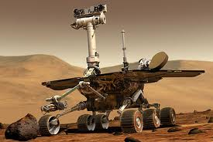
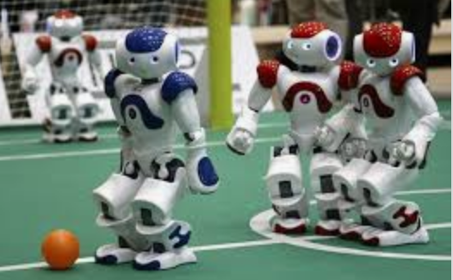
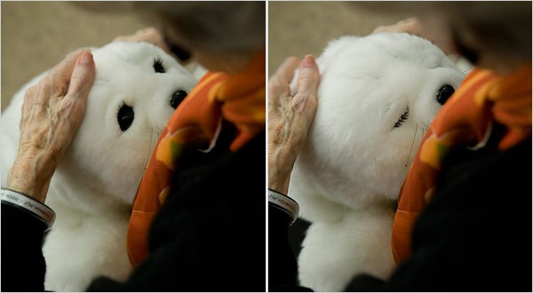
AI Applications: Robotics
Autonomous vehicles
Vehicles for exploring space, hazardous environments
Autonomous drones
Soccer robots
RoboCup
Personal robots
Humanoid robots
Robotic pets
Personal assistants?

Slide 14
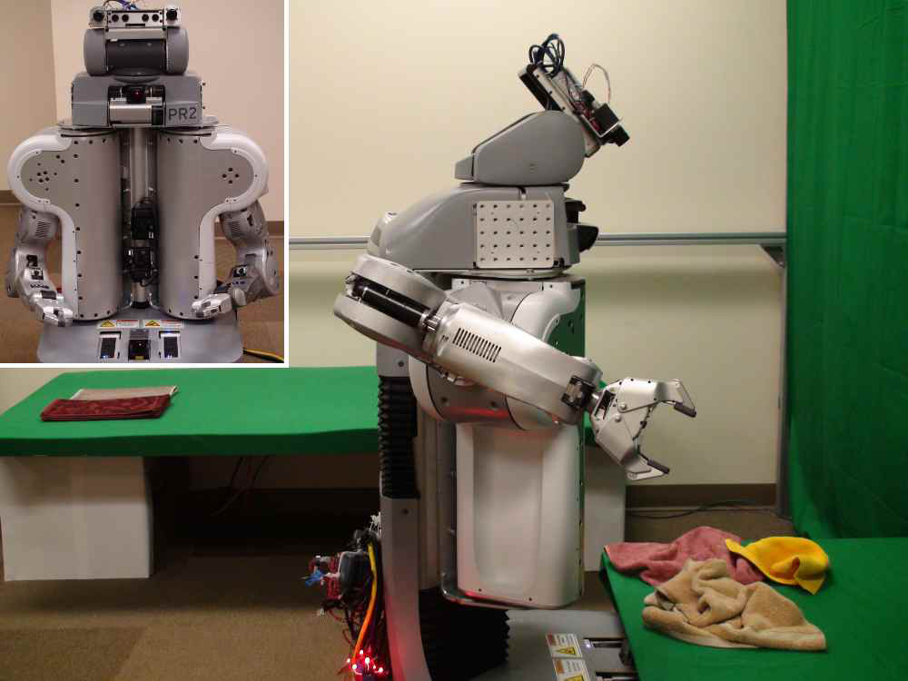
Towel-folding robot
YouTube Video
J. Maitin-Shepard, M. Cusumano-Towner, J. Lei and P. Abbeel, Cloth Grasp Point Detection based on Multiple-View Geometric Cues with Application to Robotic Towel Folding, ICRA 2010

Slide 15
Focus of this class
We will learn not only AI techniques but also how to implement them using popular Python AI packages.
Thus, this class is a class emphasizing both theory and hands-on

Slide 16
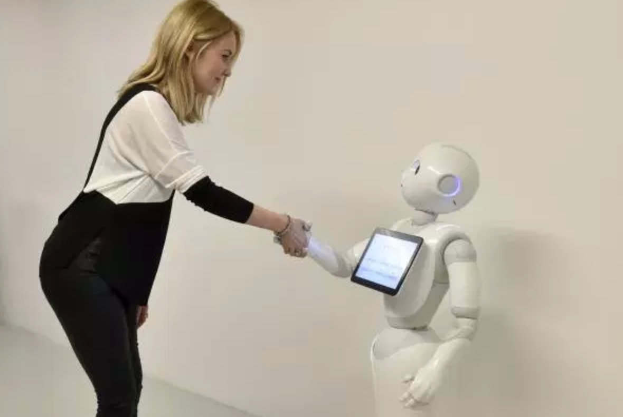
Smart Agent

Slide 17
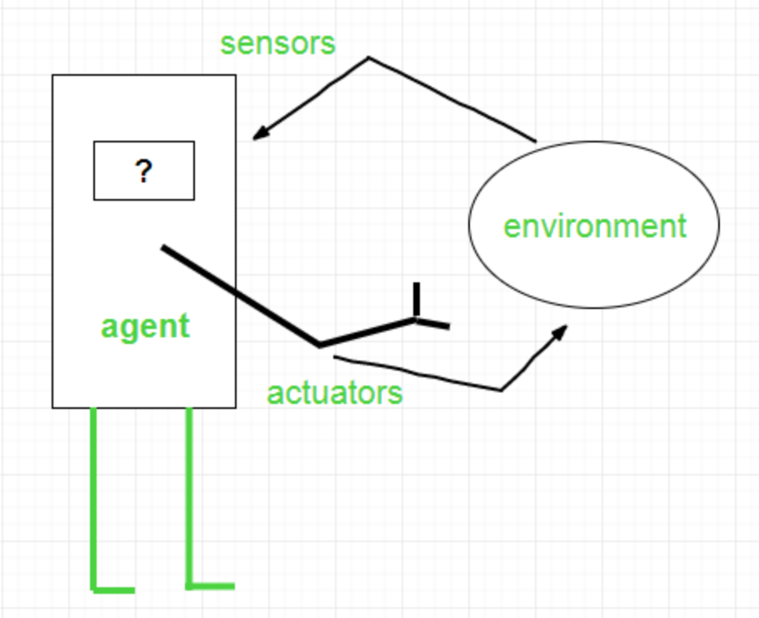
Agents
An agent is a software which observes input through sensors and acts upon an environment using actuators

Slide 18
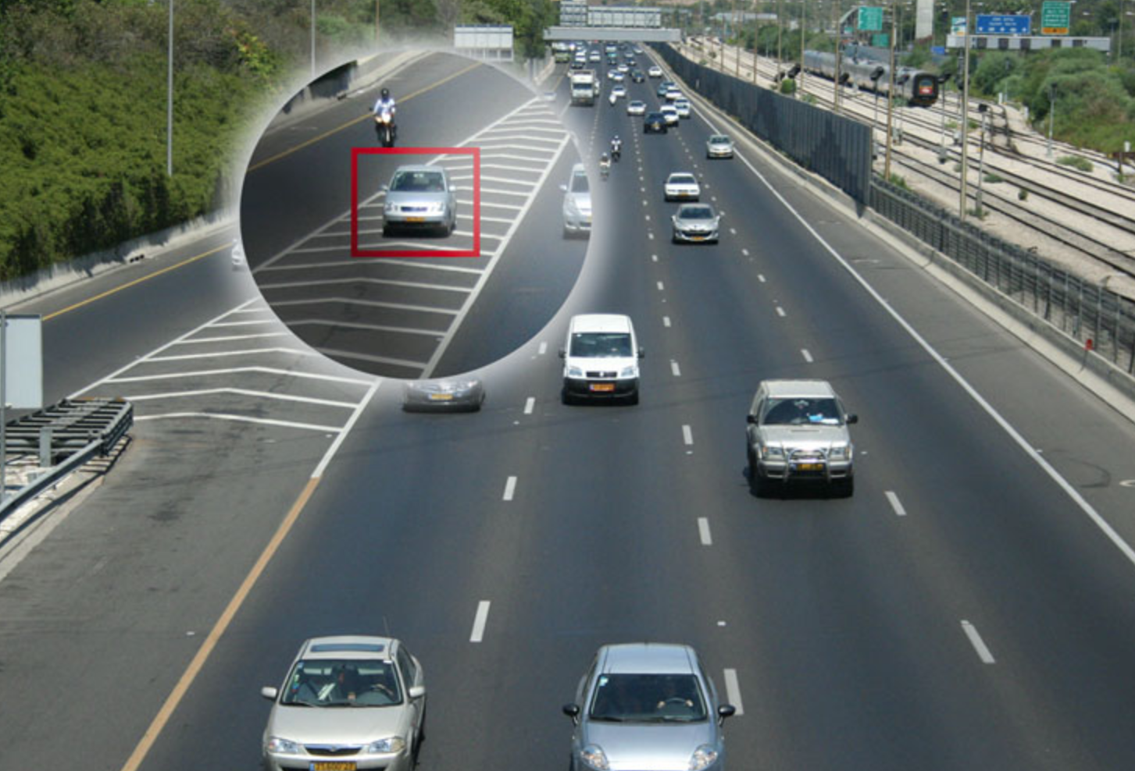
Smart agents
Given input from sensor, a smart agent should take an action that will maximize its performance measure.
Performance measure: utility objective function:

Slide 19
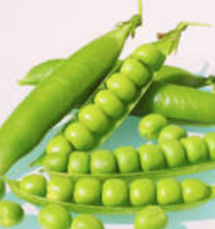
PEAS model: on which most of AI agents work upon
PEAS: Performance measure, Environment states, Actuators, Sensors
P: an objective function the agent is maximizing (or minimizing)
E: a formal representation for states
A state = a group of variables
= a tuple of (var₁=val₁, var₂=val₂, … ,var_{n}=val_{n})
A: actions that change the agent state according to a transition model
S: observations that allow the agent to infer the world state

Slide 20
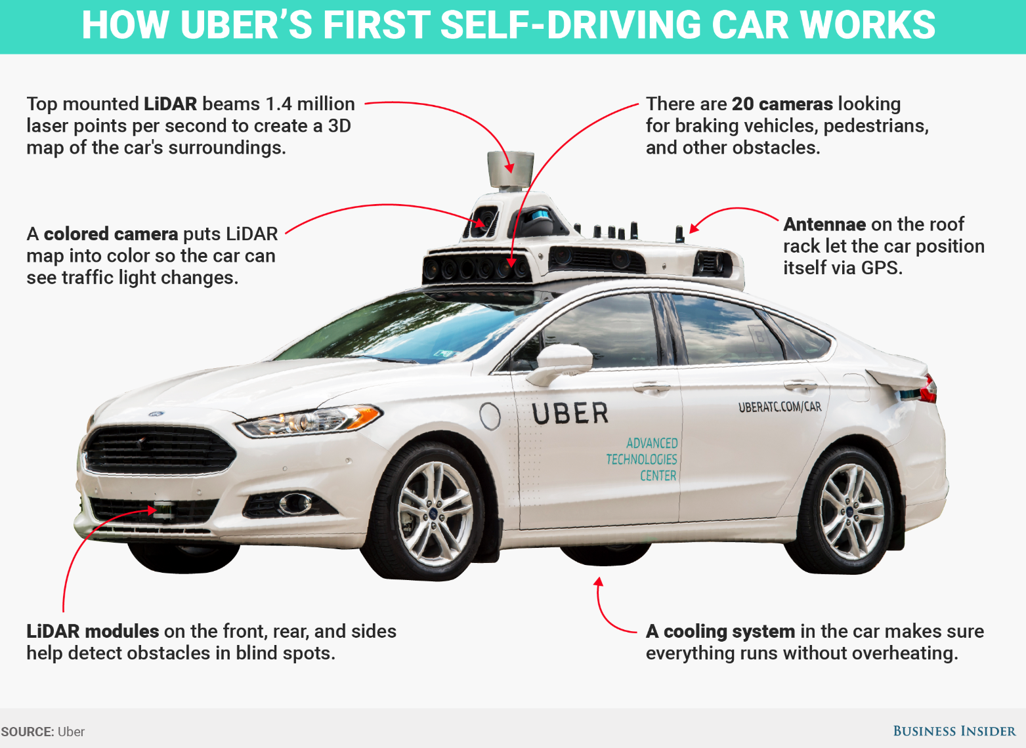
PEAS Example: Autonomous taxi
Performance measure
function for a safe, fast, legal, comfortable trip
Environment states
Roads, traffic, pedestrians
Actuators
Steering wheels, engine, brake, signal,
Sensors
Cameras, LIDAR, speedometer, GPS, odometer, engine sensors, keyboard

Slide 21
Another PEAS example: Email spam filter
Performance measure
Minimizing false positives, false negatives
Environment states
A user’s email account, email server
Actuators
Mark as spam, delete, etc.
Sensors
Incoming messages, other information about user’s account

Slide 22
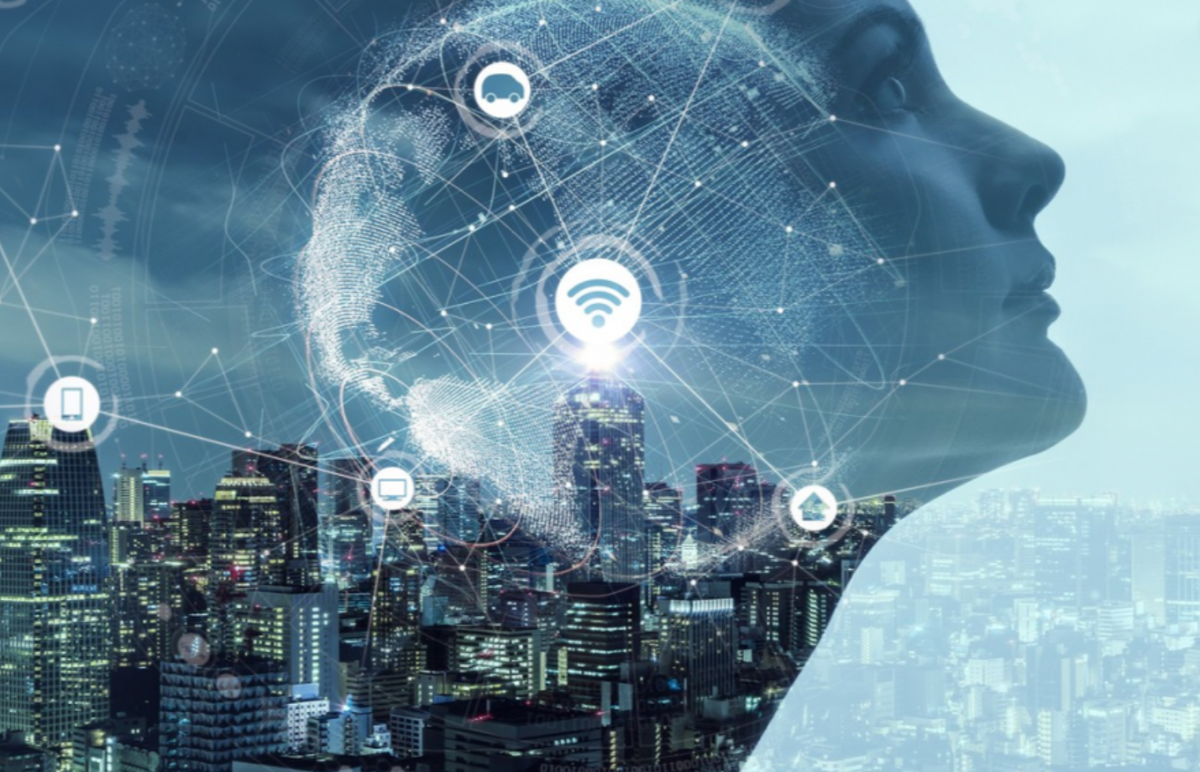
Video
What AI can do today?

Slide 23
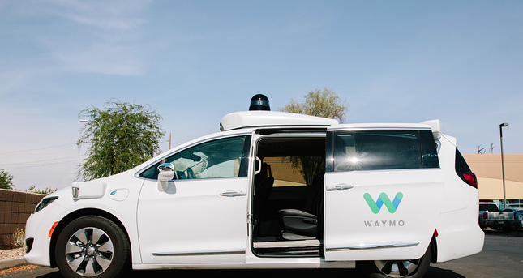
Video
Waymo (Google) self-driving cars get green light to carry passengers in California

